Slide 1
Customer Segmentation with Actionable Business Insights
Task 8 – Machine Learning Project
Dataset: Marketing Campaign (Customer Personality Analysis)
Presented by: S. GayathriG40-AIML

Slide 2
Problem Statement
Businesses often struggle to understand customer purchasing behavior, making it difficult to create effective marketing campaigns.
Without customer segmentation:
Marketing budgets are wasted.
Customer retention decreases.
Personalized recommendations become difficult.
High-value customers are not identified effectively.

Slide 3
Proposed Solution
Develop a machine learning-based customer segmentation system using clustering and predictive analytics to support data-driven business decisions.

Slide 4
Objectives
Analyze customer purchasing behavior.
Perform Exploratory Data Analysis (EDA).
Build customer segments using K-Means Clustering.
Predict customer spending using Regression.
Predict campaign response using Logistic Regression.
Optimize models using GridSearchCV.
Generate actionable business recommendations.

Slide 5
Dataset Overview Dataset Name: Marketing Campaign (Customer Personality Analysis)
Features
Customer Demographics
Annual Income
Education
Marital Status
Website Purchases

Slide 6
Features
Store Purchases
Catalog Purchases
Product Spending
Campaign Response
Recency
Customer Complaints
Feature Engineering
Created:
Age
Children
Total Spending

Slide 7
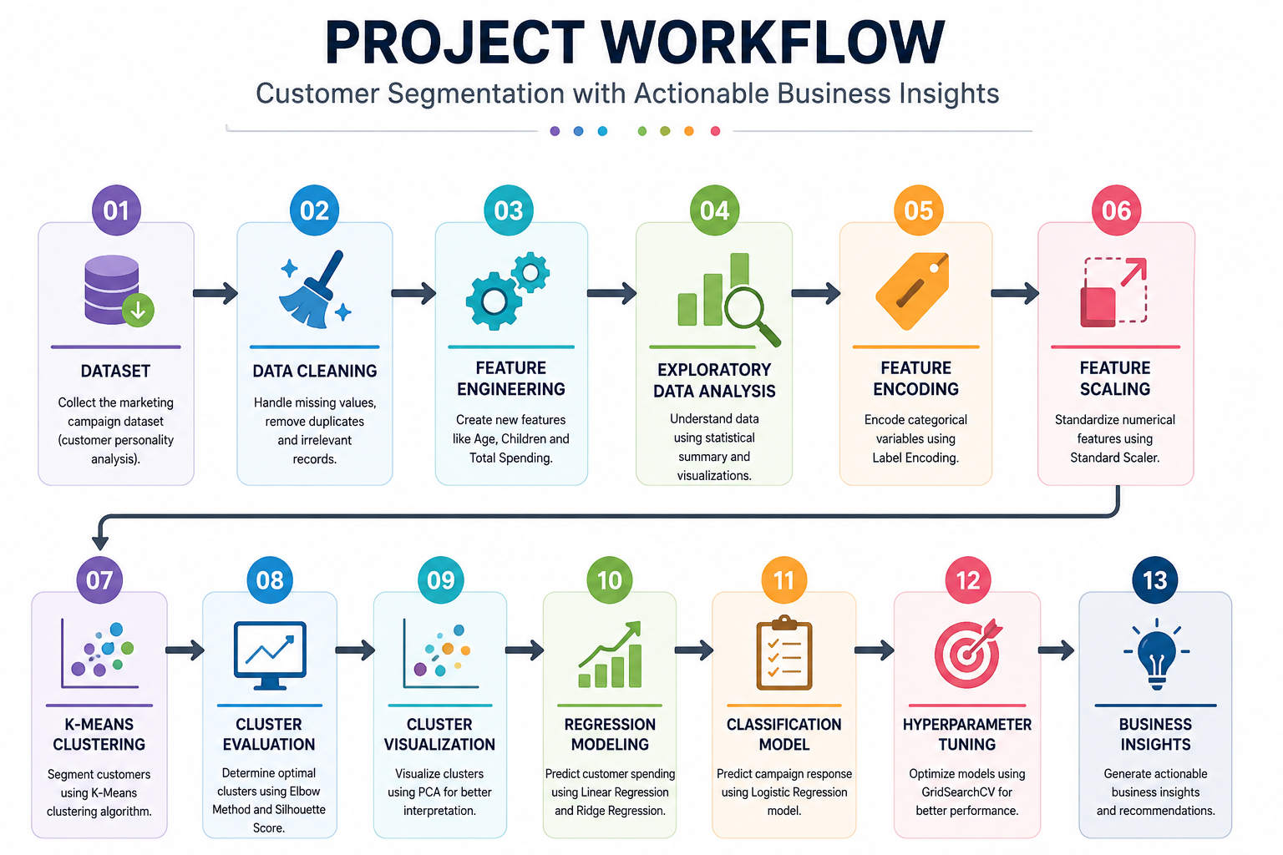

Slide 8
Exploratory Data Analysis
Performed
Missing Value Analysis
Duplicate Removal
Statistical Summary
Distribution Analysis
Correlation Analysis

Slide 9
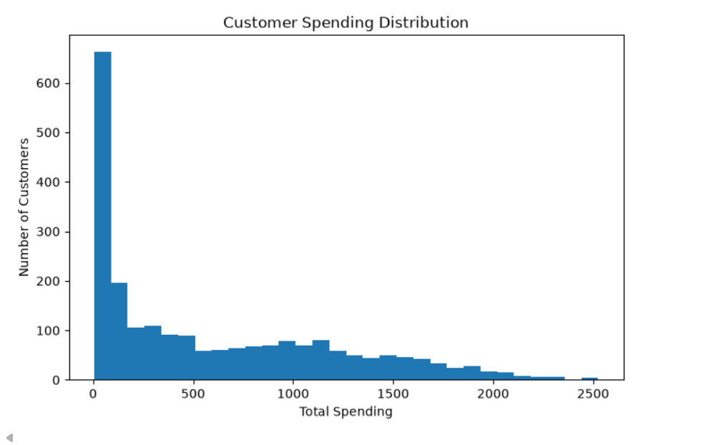
Visualizations

Slide 10
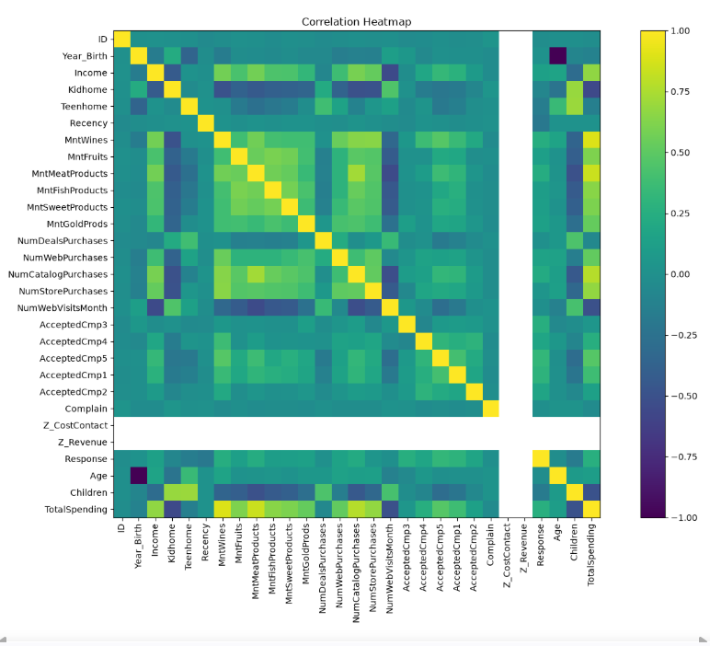
Correlation Heatmap

Slide 11
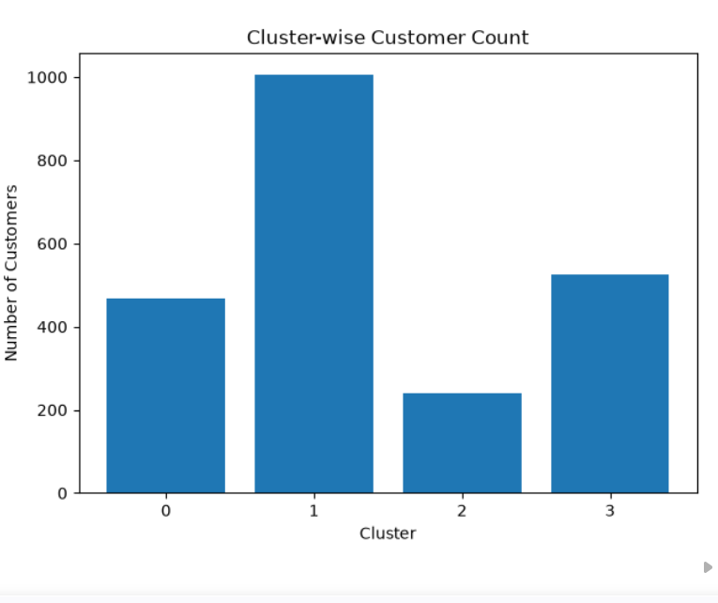
Cluster-wise Customer Count

Slide 12
Data Preprocessing
Steps
Removed duplicate records
Filled missing Income values
Encoded categorical variables
Standardized numerical features
Created Total Spending feature
Created Age feature
Created Children feature
Tools Used
LabelEncoder
StandardScaler

Slide 13
Customer Segmentation
K-Means Clustering
Cluster Selection
Elbow Method
Silhouette Score
Clustering Features
Income
Total Spending
Recency
Website Purchases
Store Purchases
Catalog Purchases
Age
Children

Slide 14
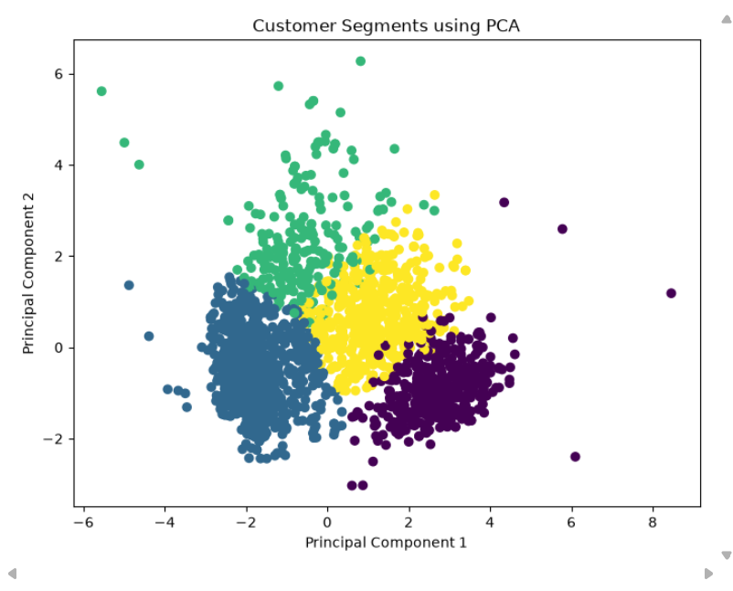
Customer Segments using PCA

Slide 15
Regression Models
Spending Prediction
Models Used
Linear Regression
Ridge Regression
Evaluation Metrics
Mean Absolute Error (MAE)
Mean Squared Error (MSE)
Root Mean Squared Error (RMSE)
R² Score
Observation
Ridge Regression reduced overfitting while maintaining good prediction accuracy.

Slide 16
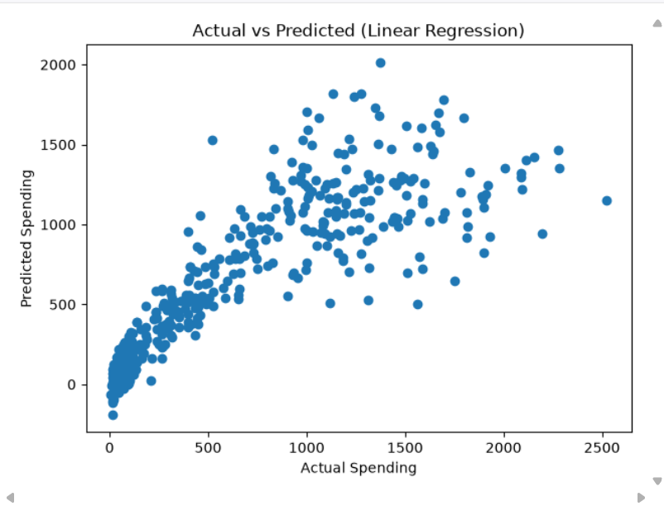
Actual vs Predicted

Slide 17
Classification Model Campaign Response Prediction
Model
Logistic Regression
Hyperparameter Optimization
GridSearchCV
Evaluation Metrics
Accuracy
Precision
Recall
F1-Score
ROC-AUC Score
Confusion Matrix
Result
The optimized Logistic Regression model effectively predicts customers who are likely to respond to future marketing campaigns.

Slide 18
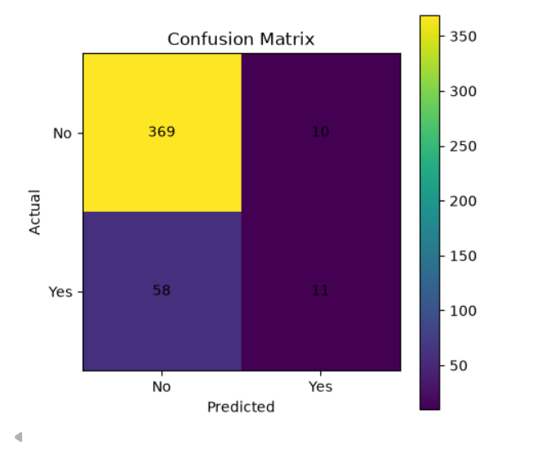
Confusion Matrix

Slide 19
Model Comparison Model performance
Model | Objective | Evaluation
K-Means | Customer Segmentation | Silhouette Score
Linear Regression | Spending Prediction | R², RMSE
Ridge Regression | Spending Prediction | Improved Generalization
Logistic Regression | Campaign Response | Accuracy, F1, ROC-AUC
Selected Models
K-Means for Segmentation
Ridge Regression for Spending Prediction
Logistic Regression for Campaign Response

Slide 20
Business Insights
High-Value Customers
Premium memberships
Exclusive offers
Early access to new products
Regular Customers
Loyalty rewards
Product recommendations
Potential Customers
Welcome campaigns
Personalized discounts
At-Risk Customers
Re-engagement emails
Special promotional offers

Slide 21
Conclusion
Successfully segmented customers using K-Means Clustering.
Built regression and classification models.
Optimized models using GridSearchCV.
Generated actionable business recommendations.
Demonstrated how machine learning supports data-driven marketing.

Slide 22
Future Scope
Real-time customer segmentation
Deep learning models
Customer Lifetime Value prediction
Cloud deployment
Integration with CRM systems

Slide 23
Thank You.!
Presented by:
S. GayathriG40-AIML

